Slide 1



SOCIAL LISTENING REPORT
Product Tracking: Nokia Brand, Nokia 7.2, Nokia2.3 & Android 10
Period report: 01/01/2020 – 31/03/2020

Slide 2
OBJECTIVE
Campaign : Nokia Brand & Nokia 7.2 & Nokia 2.3 & Android 10
Brand : HMD Nokia
Objectives : Measure the results of social media discussions about Nokia brand, Nokia 7.2, Nokia 2720 Flip
Channels : Vietnam’s online news & social media (social networks, videos, forums, blogs, reviews sites, major e – retailers, …)
Period : January 01, 2020 – March 30, 2020
Report focus:
Volume & Engagement of Nokia Brand/ Product
Overall Performance by channels
Sentiment Performance of Nokia Brand/ Product
Top Content & Top Sources

Slide 3
SOCIAL INSIGHT & RECOMMENDATION
Research & Solutions

Slide 4
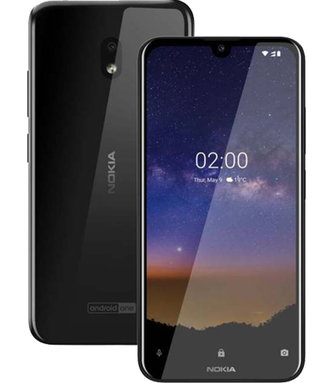
NOKIA BRAND

Slide 5


OVERALL
Post | 1,000
Like | 10,123
Comment | 6,789
Share | 1,234
Mention | 7,789
Engagement | 18,146
GENDER
53.0%
36.6%
Others
10.2%
Location | Ratio
Ho Chi Minh | 14.8%
Ha Noi | 10%
Nghe An | 1.9%
Dong Nai | 1.7%
Da Nang | 1.6%
Others | 71.9%
Index:
-0.20
AGE

Slide 6
NOKIA 7.2

Slide 7
OVERALL
Post | 1,000
Like | 10,123
Comment | 6,789
Share | 1,234
Mention | 7,789
Engagement | 18,146
GENDER
53.0%
36.6%
Others
10.2%
Location | Ratio
Ho Chi Minh | 14.8%
Ha Noi | 10%
Nghe An | 1.9%
Dong Nai | 1.7%
Da Nang | 1.6%
Others | 71.9%
Index:
-0.20
AGE

Slide 8
NOKIA 2.3

Slide 9
OVERALL
Post | 1,000
Like | 10,123
Comment | 6,789
Share | 1,234
Mention | 7,789
Engagement | 18,146
GENDER
53.0%
36.6%
Others
10.2%
Location | Ratio
Ho Chi Minh | 14.8%
Ha Noi | 10%
Nghe An | 1.9%
Dong Nai | 1.7%
Da Nang | 1.6%
Others | 71.9%
Index:
-0.20
AGE

Slide 10
ANDROID 10

Slide 11
OVERALL
Post | 1,000
Like | 10,123
Comment | 6,789
Share | 1,234
Mention | 7,789
Engagement | 18,146
GENDER
53.0%
36.6%
Others
10.2%
Location | Ratio
Ho Chi Minh | 14.8%
Ha Noi | 10%
Nghe An | 1.9%
Dong Nai | 1.7%
Da Nang | 1.6%
Others | 71.9%
Index:
-0.20
AGE

Slide 12

Thank
For Your Interest

